Slide 1

WELCOME
TO OUR PRESENTATION

Slide 2

A Presentation on
Smart Fire-Fighter Robot
(ASPHYXIATOR18)
Ref. info: HARD18

Slide 3

TEAM: RUET ETErnals

Slide 4

Introduction
Required Apparatus
Required Apps and Software
Block Diagrams
Project Image and video
Working Process
Application
It’s Future
Conclusion

Slide 5
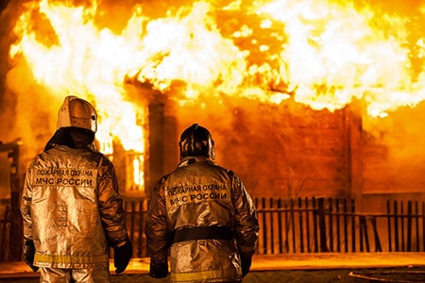
introduction
A robot is a type of automated machine that can execute specific tasks with little or no human intervention and with speed and precision. Robot can be executed in various task to eradicate human risk and labor. Smart fire fighting robot is introduced to minimize the risk of a firefighter and also confronted with different troubles especially when the fire happens in a tight and limited region. This robot can detect even a small amount of fire and automatically extinguish the fire to prevent damages.

Slide 6
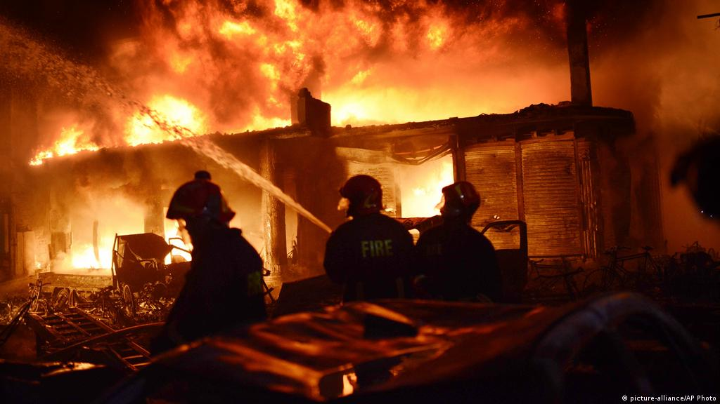
The main reason why we made this project is because of its social importance.
As we know that extinguishing fire is a very risky task. If a large scale fire incident occurs then the evacuation process and extinguish the fire can be done by using this robot.
Most of the times it’s not easy for the fire workers to directly jump into the incident place in order to save people and also it’s very hard to know exactly the location of people. This robot can solve this problem.
Also if a building collapses and there is too much smoke and fire then this robot can track people as well as can extinguish the fire and can reduce the smoke.
The robot will make the fire workers work less risky and the whole task can be done in lesser time.
As now urbanization is rapidly increasing, the chances of massive fire breaking out is also increasing. Also our country is densely populated so it is now high time to take the help of technology. In this way the people who are on the edge of life and death and workers who are working to save those people can have a better chance of survival.
WHY!!

Slide 7
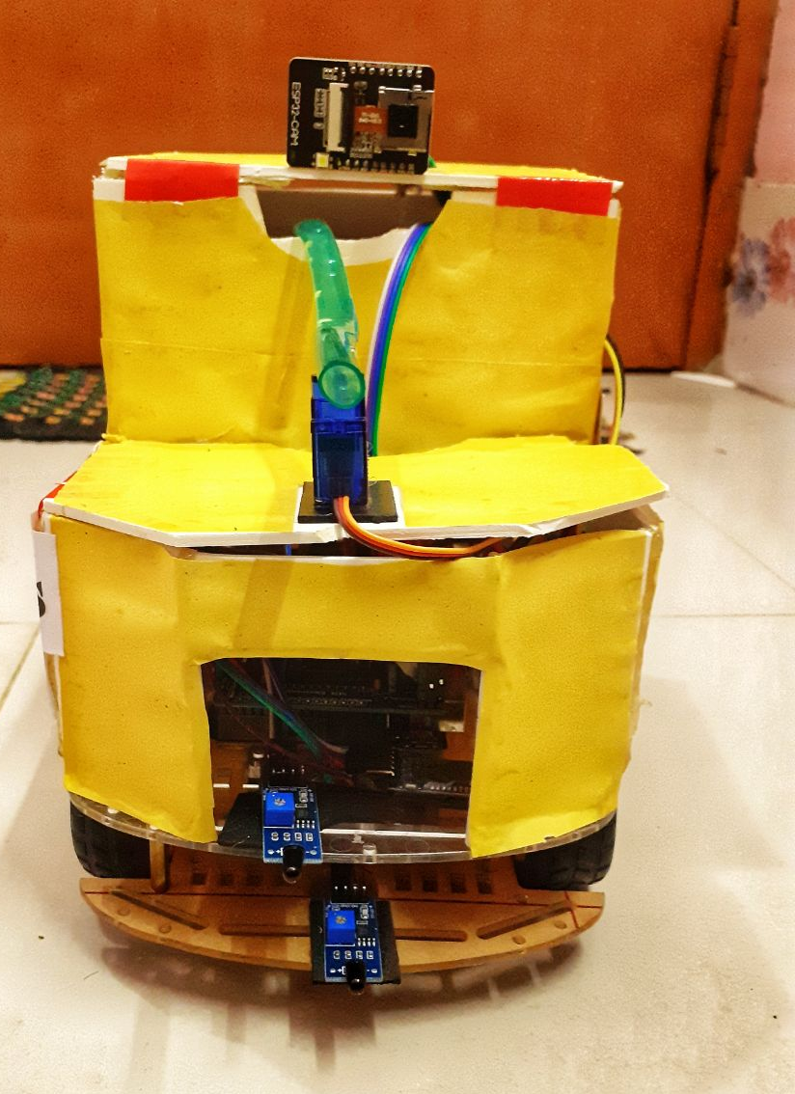
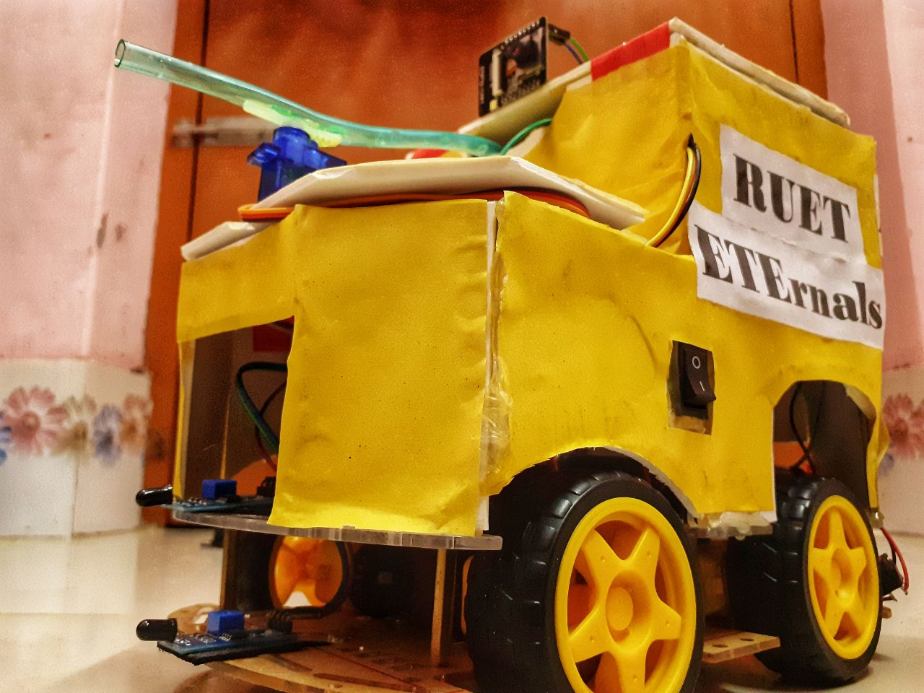
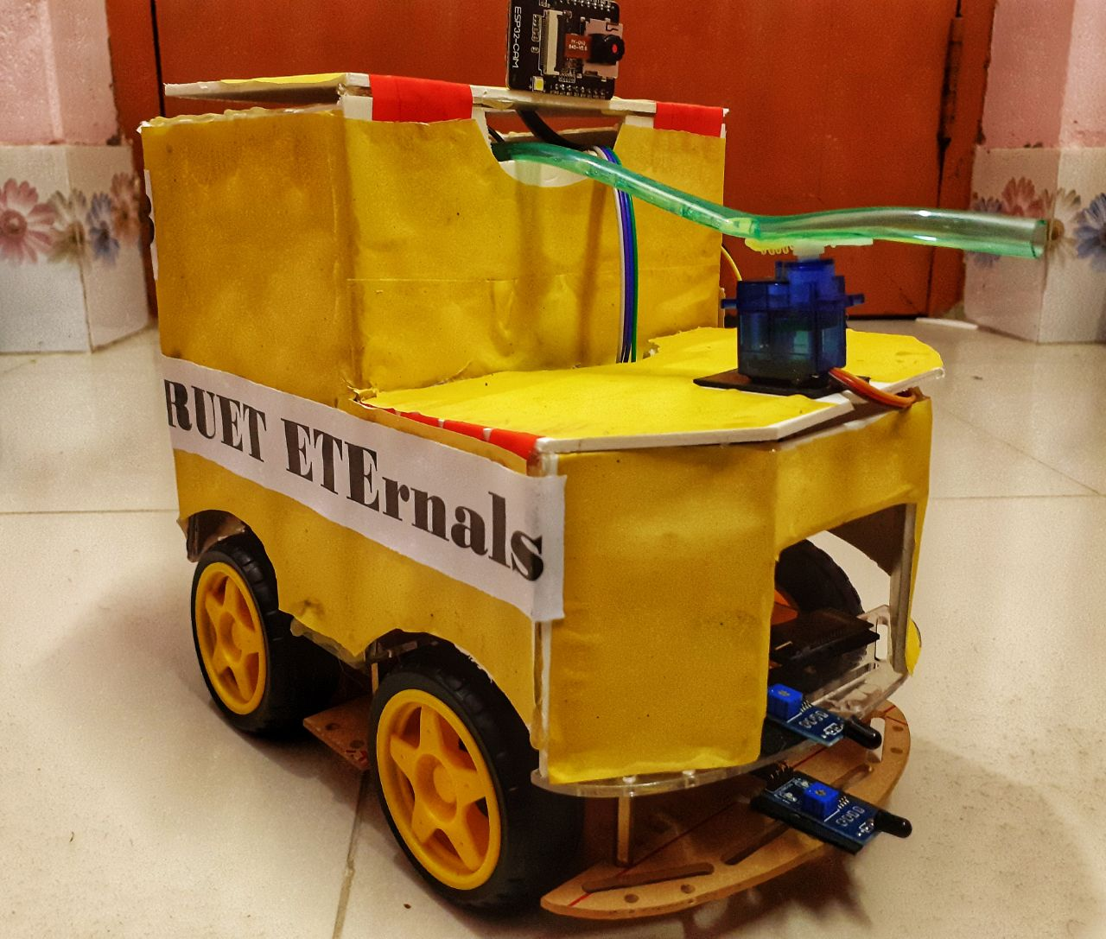
THE Project

Slide 8

Required Apparatus
Arduino Uno
L293D Motor Driver Shield
Gear Motor and wheels
HC-05 Bluetooth Module
IR Flame Sensor
18650 Li-ion Battery
DC Water Pump
Relay Module 5V
ESP32 CAM
Car Chassis
Servo Motor

Slide 9
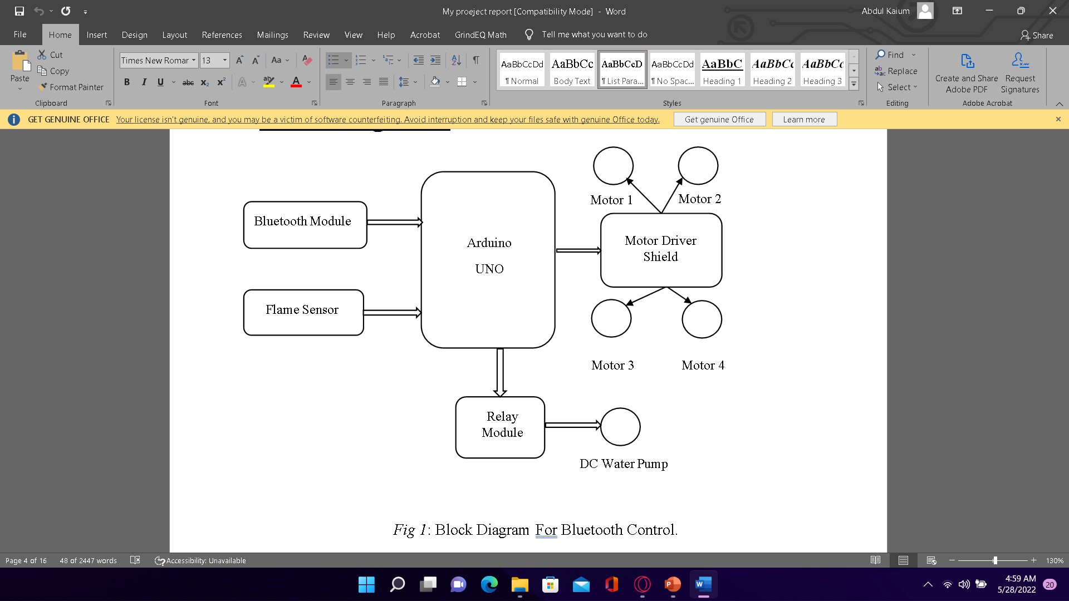
Block diagrams

Slide 10
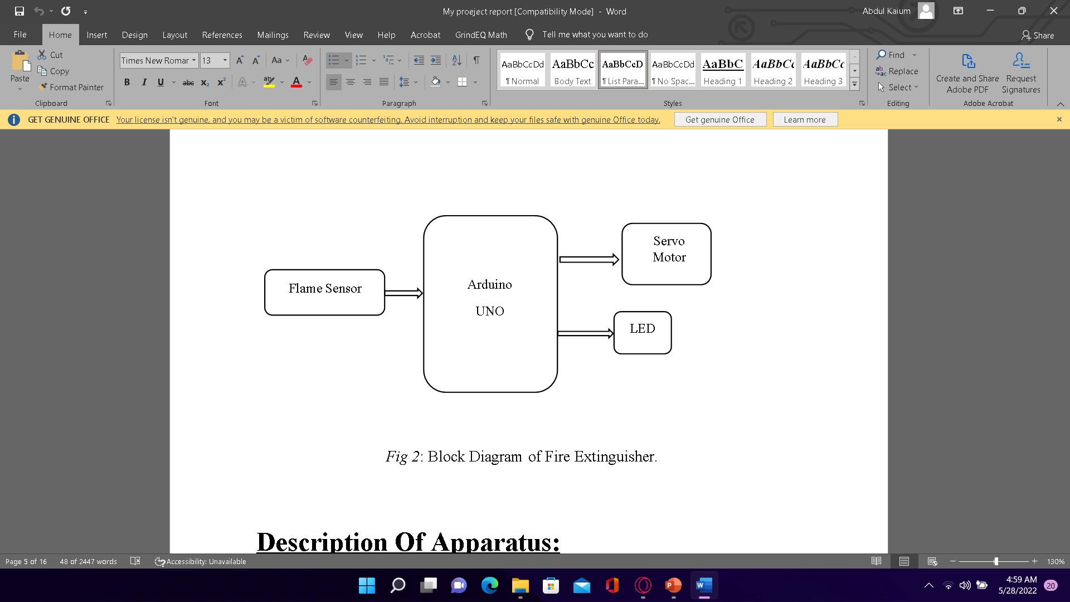
Block diagrams

Slide 11
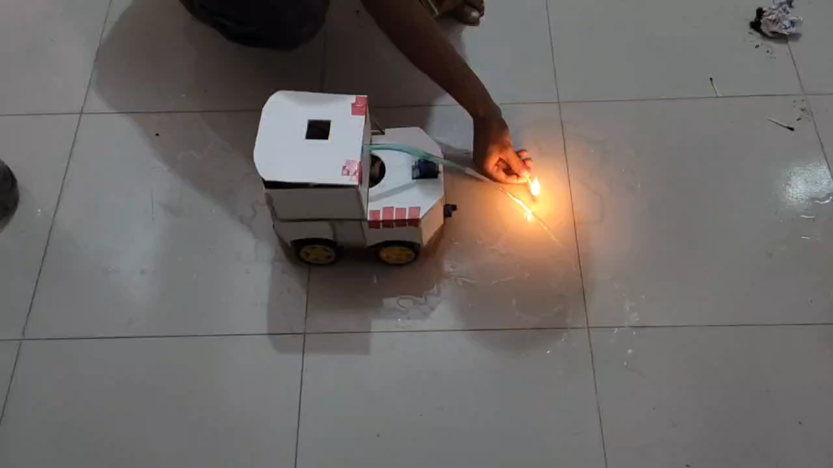
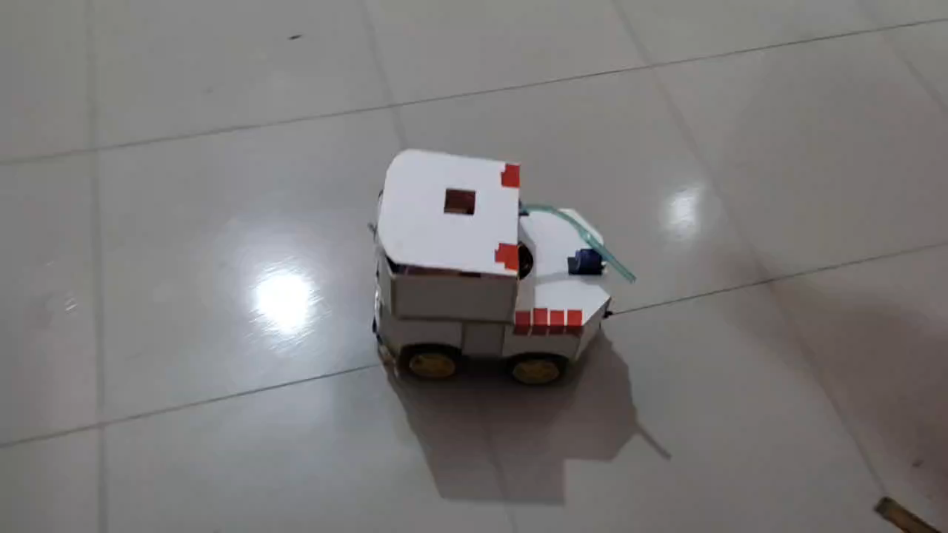
Project Video

Slide 12

Working process
The project was about an Arduino based Bluetooth controlled fire fighting robot which can be easily control by a smartphone as it has one HC05 Bluetooth module connected to control its movement. Flame sensor is also connected to the Arduino through motor driver shield, which is used to sense or detect the fire. Motor driver shield used to drive the gear motor to run the robot. Then the relay module got input from Arduino to start the DC water pump if needed. Another Arduino is connected with another flame sensor and a servo motor to spray the water in every angle when fire is detected.

Slide 13
Applications
The main purpose of this project is to eradicate the high risk of human and fire fighters in front line and to minimize the damage of goods and lives.
As this robot can be controlled from a remote place via wireless system, it can easily be used in any tight and limited region.
The robot can move in every side and everywhere by users command. So the user can drive it to the fire and extinguish it.
Flame sensor is included to the project so that it can detect fire automatically and spray water in flame.
It can also be used for surveillance by using any camera module with it, which will help users to find any injured person or any other internal flame incidents.

Slide 14
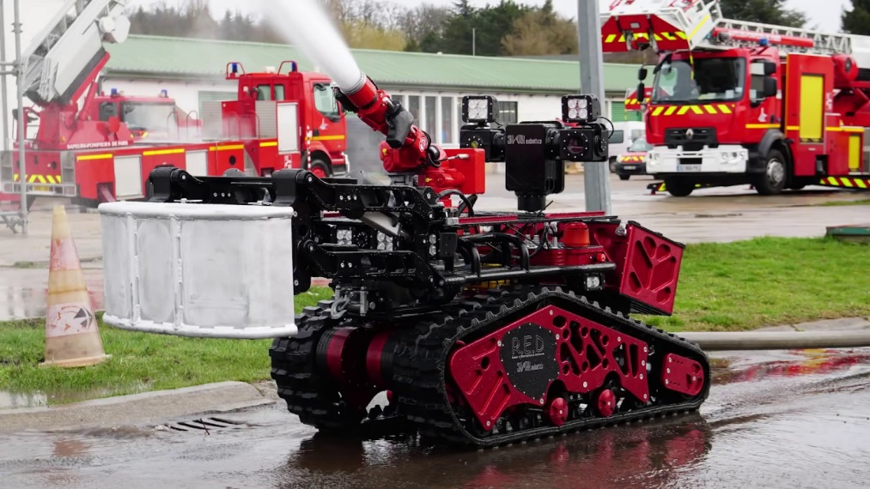
IT’s future
In our country, the use of technology for fire fighting is very less. So it’s high time to start using such technologies. Our prototype is a demo version of it. If we can go ahead with it with far more modification and upgradation then the prototype will have a potentiality to really use it in practical scenarios. Many modern countries are now making these type of prototypes in order to avoid catastrophic situations. In future with more idea, with more implementation of those ideas this prototype can be more advanced.

Slide 15
conclusion
Through this it can conclude that a robot can be used in place of humans reducing the risk of life of the firefighters. This can be used in our homes, labs, offices etc. They provide us greater efficiency to detect the flame and it can be extinguished before it become uncontrollable and threat to life. Hence, this robot can play a crucial role. In future this project can be extended by using artificial intelligence for automation operations.

Slide 16
Team Members
Sk Abdul Kaium
Dept. Of ETE
RUET
Minhazul Islam
Dept. Of ETE
RUET
Farzana Akter
Lecturer, Dept. of ETE
RUET

Slide 17
Thank you

